Slide 1
Virtual Memory, Address-Translation and Paging
INF-2201 Operating Systems – Spring 2019
Lars Ailo Bongo (larsab@cs.uit.no)
… based on presentations created by
Lars Ailo Bongo, Tore Brox-Larsen, Bård Fjukstad, Daniel Stødle, Otto Anshus, Thomas Plagemann, Kai Li, Andy Bavier
Tanenbaum & Bo,Modern Operating Systems:4th ed.

Slide 2
Overview
Part 1
Virtual Memory
Virtualization
Protection
Address Translation
Base and bound
Segmentation
Paging
Translation look-ahead buffer
Part 2: Paging and replacement
Part 3: Design Issues

Slide 3
Latency Numbers Every Programmer Should Know
Latency Comparison Numbers (~2012)
--------------------------
L1 cache reference 0.5 ns
Branch mispredict 5 ns
L2 cache reference 7 ns 14x L1 cache
Mutex lock/unlock 25 ns
Main memory reference 100 ns 20x L2 cache, 200x L1 cache
Compress 1K bytes with Zippy 3,000 ns
Send 1K bytes over 1 Gbps network 10,000 ns 0.01 ms
Read 4K randomly from SSD* 150,000 ns 0.15 ms
Read 1 MB sequentially from memory 250,000 ns 0.25 ms
Round trip within same datacenter 500,000 ns 0.5 ms
Read 1 MB sequentially from SSD* 1,000,000 ns 1 ms 4X memory
Disk seek 10,000,000 ns 10 ms 20x datacenter roundtrip
Read 1 MB sequentially from disk 20,000,000 ns 20 ms 80x memory, 20X SSD
Send packet CA->Netherlands->CA 150,000,000 ns 150 ms
Notes
-----
1 ns = 10-9 seconds
1 ms = 10-3 seconds
* Assuming ~1GB/sec SSD
Credit
------
By Jeff Dean: http://research.google.com/people/jeff/
Originally by Peter Norvig: http://norvig.com/21-days.html#answers
Source: https://gist.github.com/jboner/2841832

Slide 4
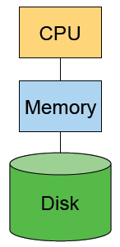
The Big Picture
DRAM is fast, but relatively expensive
$25/GB
20-30ns latency
10-80GB’s/sec
Disk is inexpensive, but slow
$0.2-1/GB (100 less expensive)
5-10ms latency (100K times slower)
40-80MB/sec per disk (1,000 times less)
Our goals
Run programs as efficiently as possible
Make the system as safe as possible

Slide 5
Issues
Many processes
The more processes a system can handle, the better
Address space size
Many small processes whose total size may exceed memory
Even one process may exceed the physical memory size
Protection
A user process should not crash the system
A user process should not do bad things to other processes

Slide 6
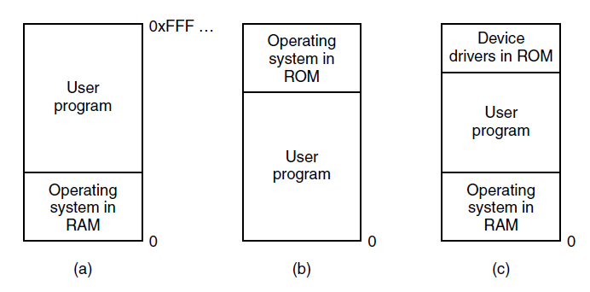
No Memory Abstraction
Figure 3-1. Three simple ways of organizing memory with an operating system and one user process. Other possibilities also exist
Tanenbaum & Bo,Modern Operating Systems:4th ed., (c) 2013 Prentice-Hall, Inc. All rights reserved.

Slide 7
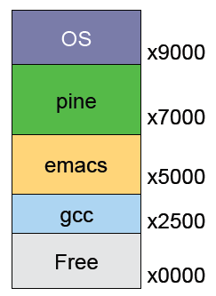
A Simple System
Only physical memory
Applications use physical memory directly
Run three processes
emacs, pine, gcc
What if
gcc has an address error?
emacs writes at x7050?
pine needs to expand?
emacs needs more memory than is on the machine?

Slide 8
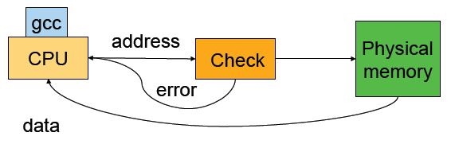
Protection Issues
Errors in one process should not affect others
For each process, check each load and store instruction to allow only legal memory references

Slide 9
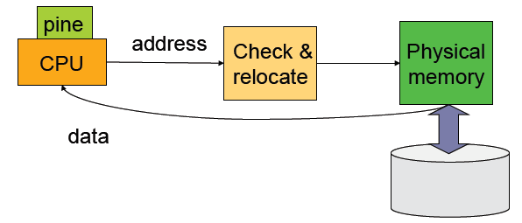
Expansion or Transparency Issue
A process should be able to run regardless of its physical location or the physical memory size
Give each process a large, static “fake” address space
As a process runs, relocate each load and store to its actual memory

Slide 10
Virtual Memory
Flexible
Processes can move in memory as they execute, partially in memory and partially on disk
Simple
Make applications very simple in terms of memory accesses
Efficient
20/80 rule: 20% of memory gets 80% of references
Keep the 20% in physical memory
Design issues
How is protection enforced?
How are processes relocated?
How is memory partitioned?

Slide 11
Address Mapping and Granularity
Must have some “mapping” mechanism
Virtual addresses map to DRAM physical addresses or disk addresses
Mapping must have some granularity
Granularity determines flexibility
Finer granularity requires more mapping information
Extremes
Any byte to any byte: mapping equals program size
Map whole segments: larger segments problematic

Slide 12
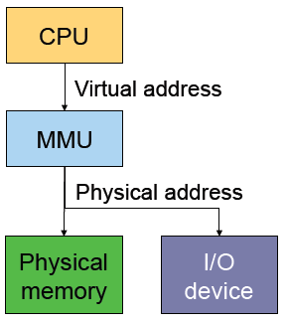
Generic Address Translation
Memory Management Unit (MMU) translates virtual address into physical address for each load and store
Software (privileged) controls the translation
CPU view
Virtual addresses
Each process has its own memory space [0, high]
Address space
Memory or I/O device view
Physical addresses

Slide 13
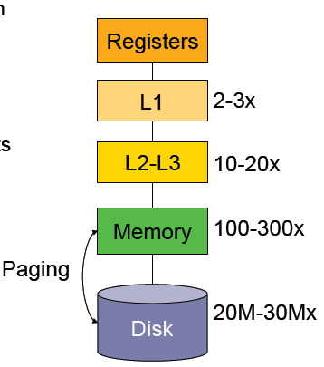
Goals of Translation
Implicit translation for each memory reference
A hit should be very fast
Trigger an exception on a miss
Protected from user’s faults

Slide 14
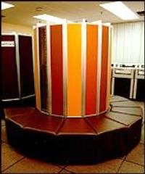
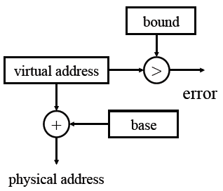
Base and Bound
Built in Cray-1
Each process has a pair (base, bound)
Protection
A process can only access physical memory in [base, base+bound]
On a context switch
Save/restore base, bound registers
Pros
Relocation possible
Simple
Flat and no paging
Cons
Fragmentation
Hard to share
Difficult to use disks

Slide 15
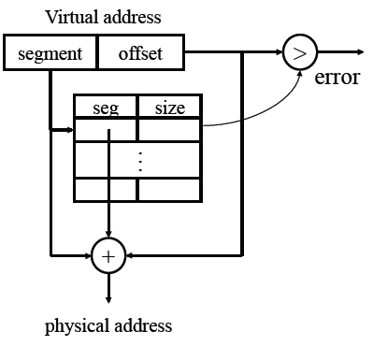
Segmentation
Each process has a table of (seg, size)
Treats (seg, size) as a fine-grained (base, bound)
Protection
Each entry has (nil, read, write, exec)
On a context switch
Save/restore the table and a pointer to the table in kernel memory
Pros
Efficient
Easy to share
Cons
Segments must be contiguous in physical memory
Fragmentation within a segment
Complex management

Slide 16
Segmentation: Example Systems
Burroughs B5000
General Electrix GE-645 (Multics)
www.multicians.org
Intel iAPX 432
IBM AS/400
X86 (limited)
Notes:
Burroughs B5000, GE-645, iAPX 432 and AS/400 are all examples of computer architectures that strive for some “higher-level” functionality.
B5000 Language (Algol) oriented architecture. Stack instruction set architecture
GE-645 Segments are a central quality, Supports Multics (see multicians.org). Ge later became Honeywell-Bull and Bull. Bull was a French computer manufacturer named after Norwegian computing pioneer and industrialist Bull.
iAPX 432 was Intels design for a 32 bit architecture breaking away from the x86-heritance. It was designed to support objects and capabilities, object oriented languages, garbage collection and other features. In Oslo iAPX 432 was referred to as a Simula-processor, whereas in the rest of the world it was similarly referred to as an Ada-architecture. This was the first time Intel tried to break away from the x86 legacy. The design was not commercially successful. Instead Intel survived on the backwards compatible, and novel, 386 architecture. A much less prestigious, possibly “undercover” project at Intel
AS/400 was a continuation of the previously System/38, a capability-based processor.
B5000, iAPX 432, and AS/400 are all describes in Steven M. Levy’s book on Capability-based computer systems.

Slide 17
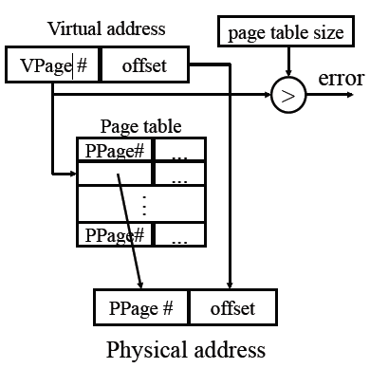
Paging
Use a fixed size unit called page instead of segment
Use a page table to translate
“Principle: Introducing (one level of) indirection”
Various bits in each entry
Context switch
Similar to segmentation
What should page size be?
Pros
Simple allocation
Easy to share
Cons
Big table
How to deal with holes?
Notes:
“Swapping” (by the OS) and “Overlays” (by the application) were techniques that predates paging.
Segmentation (without paging) also predates Paging and segmentation with paging.

Slide 18
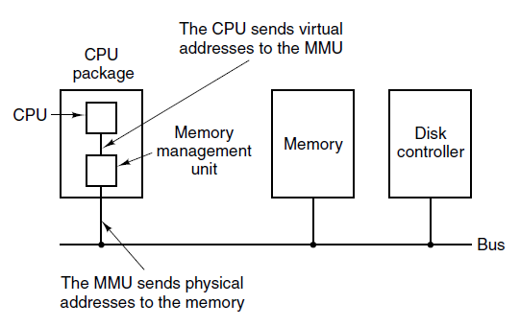
Paging (1)
Figure 3-8. The position and function of the MMU. Here the MMU is shown as being a part of the CPU chip because it commonly is nowadays. However, logically it could be a separate chip and was years ago.
Tanenbaum & Bo,Modern Operating Systems:4th ed., (c) 2013 Prentice-Hall, Inc. All rights reserved.

Slide 19
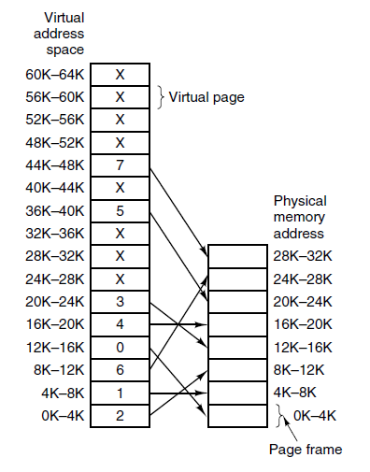
Paging (2)
Figure 3-9. The relation between virtual addresses and physical memory addresses is given by the page table. Every page begins on a multiple of 4096 and ends 4095 addresses higher, so 4K–8K really means 4096–8191 and 8K to 12K means 8192–12287
Tanenbaum & Bo,Modern Operating Systems:4th ed., (c) 2013 Prentice-Hall, Inc. All rights reserved.

Slide 20
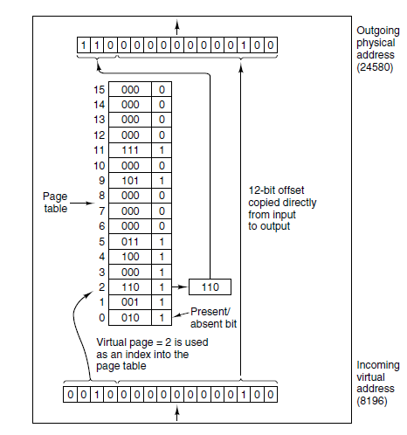
Paging (3)
Figure 3-10. The internal operation of the MMU with 16 4-KB pages.
Tanenbaum & Bo,Modern Operating Systems:4th ed., (c) 2013 Prentice-Hall, Inc. All rights reserved.

Slide 21
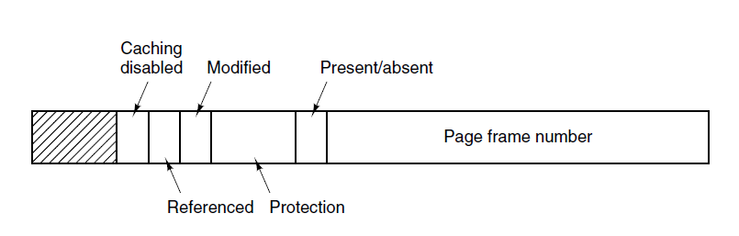
Structure of a Page Table Entry
Figure 3-11. A typical page table entry.
Tanenbaum & Bo,Modern Operating Systems:4th ed., (c) 2013 Prentice-Hall, Inc. All rights reserved.

Slide 22
Speeding Up Paging
Major issues faced:
The mapping from virtual address to physical address must be fast.
If the virtual address space is large, the page table will be large.
Tanenbaum & Bo,Modern Operating Systems:4th ed., (c) 2013 Prentice-Hall, Inc. All rights reserved.

Slide 23
How Many PTEs Do We Need?
Assume 4KB page
Equals “low order” 12 bits
Worst case for 32-bit address machine
# of processes × 2²⁰
2²⁰ PTEs per page table (~4Mbytes), but there might be 10K processes. They won’t fit in memory together
What about 64-bit address machine?
# of processes × 2⁵²
A page table cannot fit in a disk (2⁵² PTEs = 16PBytes)!

Slide 24
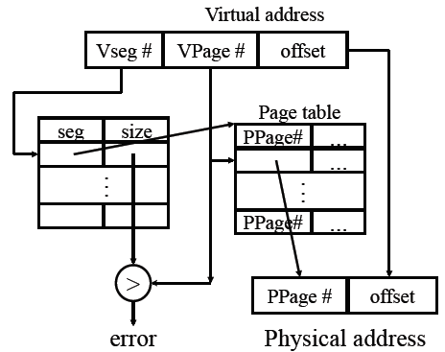
Segmentation with Paging

Slide 25
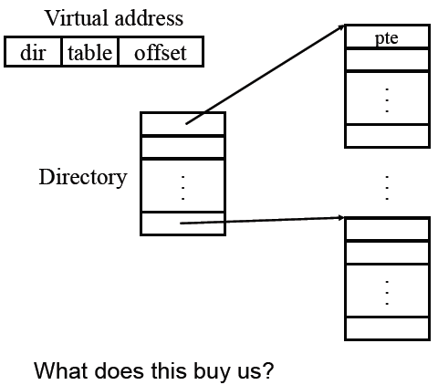
Multiple-Level Page Tables

Slide 26
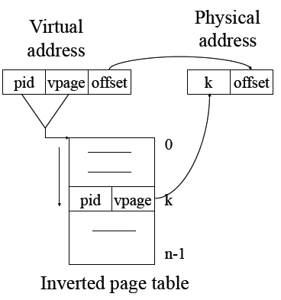
Inverted Page Tables
Main idea
One PTE for each physical page frame
Hash (Vpage, pid) to Ppage#
Pros
Small page table for large address space
Cons
Potential for poor cache performance
Lookup is difficult
Overhead of managing hash chains, etc

Slide 27
Virtual-To-Physical Lookups
Programs only know virtual addresses
Each program or process starts from 0 to high address
Each virtual address must be translated
May involve walking through the hierarchical page table
Since the page table stored in memory, a program memory access may requires several actual memory accesses
Solution
Cache “active” part of page table in a very fast memory

Slide 28
Virtual Page Lookup
From: http://www.pearsonhighered.com/samplechapter/0130610143.pdf

Slide 29
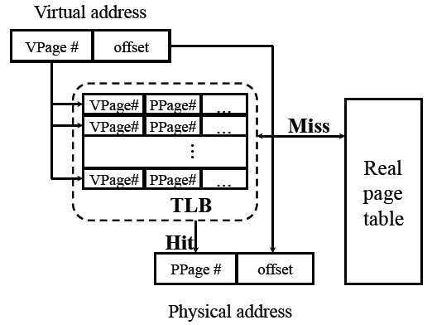
Translation Look-aside Buffer (TLB)
Notes:
Indirection through the page table by itself means that you need one (or more) extra memory accesses to get to the desired memory location. The basic idea of the TLB is to provide a cache for page-table mappings.
gRemember most programs tends to make a large number of references to a small number of pages.
TLB is a hardware feature. All lookups are done in parallel, requires specialized hardware.
Access is also checked against protection bits.
A miss is fast, a few ns if page is in memory but not in TLB.

Slide 30
Bits in a TLB Entry
Common (necessary) bits
Virtual page number: match with the virtual address
Physical page number: translated address
Valid
Access bits: kernel and user (nil, read, write)
Optional (useful) bits
Process tag
Reference
Modify
Cacheable

Slide 31
Hardware-Controlled TLB
On a TLB miss
Hardware loads the PTE into the TLB
Write back and replace an entry if there is no free entry
Generate a fault if the page containing the PTE is invalid
VM software performs fault handling
Restart the CPU
On a TLB hit, hardware checks the valid bit
If valid, pointer to page frame in memory
If invalid, the hardware generates a page fault
Perform page fault handling
Restart the faulting instruction

Slide 32
Software-Controlled TLB
On a miss in TLB
Write back if there is no free entry
Check if the page containing the PTE is in memory
If not, perform page fault handling
Load the PTE into the TLB
Restart the faulting instruction
On a hit in TLB, the hardware checks valid bit
If valid, pointer to page frame in memory
If invalid, the hardware generates a page fault
Perform page fault handling
Restart the faulting instruction

Slide 33
Hardware vs. Software Controlled
Hardware approach
Efficient
Inflexible
Need more space for page table
Software approach
Flexible
Software can do mappings by hashing
PP# → (Pid, VP#)
(Pid, VP#) → PP#
Can deal with large virtual address space

Slide 34
Caches and TLBs
Both may be single- or multiple level
Both may be unified or split
Both may offer different levels of associativit

Slide 35
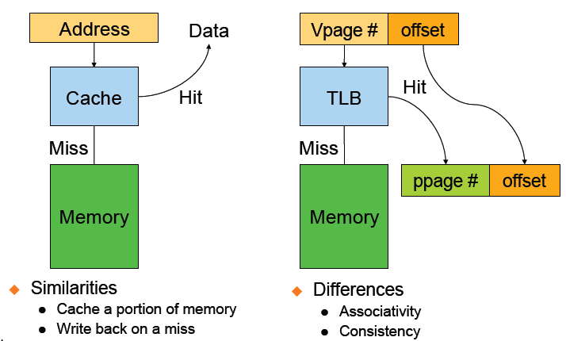
Cache vs. TLB
Notes:
Both types may be single- or multiple level, unified or split into separate I and D. If the replacement policy is free to choose any entry in the cache to hold the copy, the cache is called fully associative. At the other extreme, if each entry in main memory can go in just one place in the cache, the cache is direct mapped. Many caches implement a compromise in which each entry in main memory can go to any one of N places in the cache, and are described as N-way set associative.[7] For example, the level-1 data cache in an AMD Athlon is two-way set associative, which means that any particular location in main memory can be cached in either of two locations in the level-1 data cache.
TLBs tend to offer higher (or full) associativity than instruction-, data-, or unified caches.

Slide 36
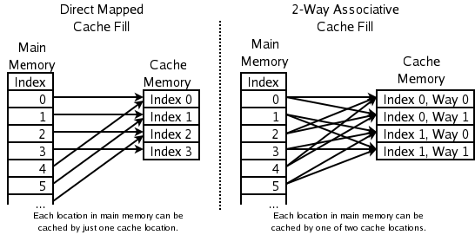
Detour: Accosiativity
http://en.wikipedia.org/wiki/File:Cache,associative-fill-both.png
Notes:
If the replacement policy is free to choose any entry in the cache to hold the copy, the cache is called fully associative. At the other extreme, if each entry in main memory can go in just one place in the cache, the cache is direct mapped. Many caches implement a compromise in which each entry in main memory can go to any one of N places in the cache, and are described as N-way set associative.[7] For example, the level-1 data cache in an AMD Athlon is two-way set associative, which means that any particular location in main memory can be cached in either of two locations in the level-1 data cache.

Slide 37
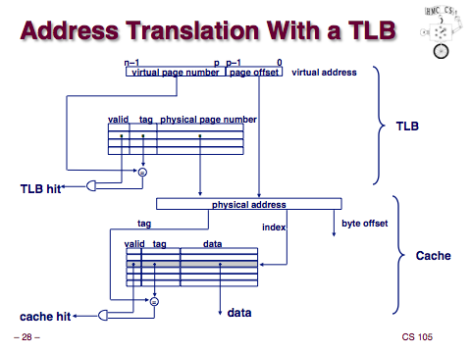
www.cs.hmc.edu/~geoff/classes/.../class14_vm1.ppt

Slide 38
TLB Related Issues
What TLB entry to be replaced?
Random
Pseudo LRU
What happens on a context switch?
Process tag: change TLB registers and process register
No process tag: Invalidate the entire TLB contents
What happens when changing a page table entry?
Change the entry in memory
Invalidate the TLB entry

Slide 39
Consistency Issues
“Snoopy” cache protocols (hardware)
Maintain consistency with DRAM, even when DMA happens
Consistency between DRAM and TLBs (software)
You need to flush related TLBs whenever changing a page table entry in memory
TLB “shoot-down”
On multiprocessors, when you modify a page table entry, you need to flush all related TLB entries on all processors, why?

Slide 40
Summary – Part 1
Virtual Memory
Virtualization makes software development easier and enables memory resource utilization better
Separate address spaces provide protection and isolate faults
Address translation
Base and bound: very simple but limited
Segmentation: useful but complex
Paging
TLB: fast translation for paging
VM needs to take care of TLB consistency issues

